Slide 1
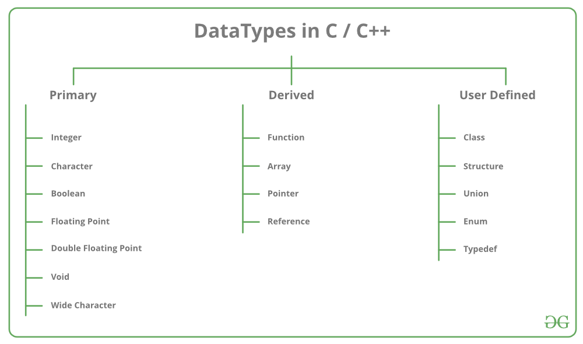

Slide 2
Type | Storage size | Value range
char | 1 byte | -128 to 127 or 0 to 255
unsigned char | 1 byte | 0 to 255
signed char | 1 byte | -128 to 127
int | 2 or 4 bytes | -32,768 to 32,767 or -2,147,483,648 to 2,147,483,647
unsigned int | 2 or 4 bytes | 0 to 65,535 or 0 to 4,294,967,295
short | 2 bytes | -32,768 to 32,767
unsigned short | 2 bytes | 0 to 65,535
long | 8 bytes or (4bytes for 32 bit OS) | -9223372036854775808 to 9223372036854775807
unsigned long | 8 bytes | 0 to 18446744073709551615

Slide 3
Variable Conversion

Slide 4
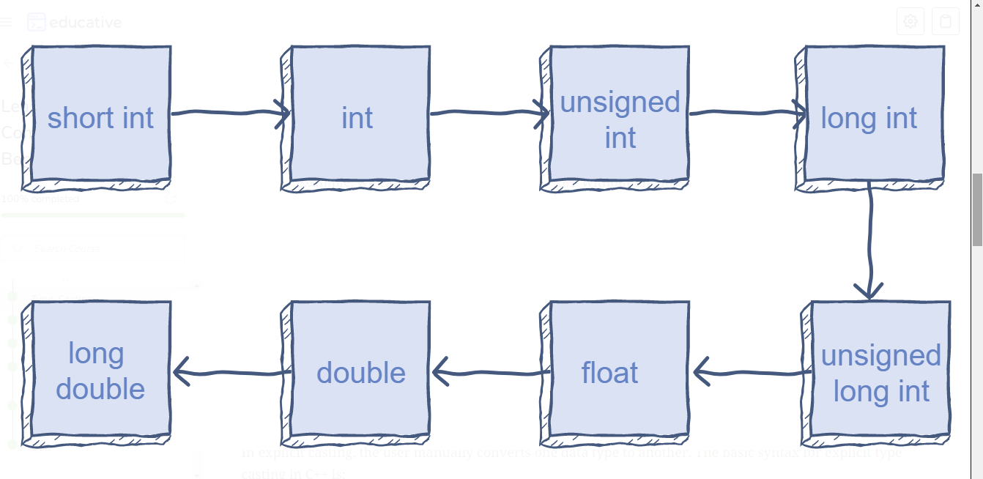

Slide 5
Math

Slide 6
Printing variables
Format Specifier | Type
%c | Character
%d | Signed integer
%e or %E | Scientific notation of floats
%f | Float values
%g or %G | Similar as %e or %E
%hi | Signed integer (short)
%hu | Unsigned Integer (short)
%i | Unsigned integer
%l or %ld or %li | Long
%lf | Double
%Lf | Long double
%lu | Unsigned int or unsigned long
%lli or %lld | Long long
%llu | Unsigned long long
%o | Octal representation
%p | Pointer
%s | String
%u | Unsigned int
%x or %X | Hexadecimal representation
%n | Prints nothing
%% | Prints % character

Slide 7
Exercise
Convert multiplication of 2 int to long

Slide 8
User input

Slide 9
Exercise
Ask user their age and print the year they were born (Image all people have birthday on the 1st of January)

